Slide 1

CNC Milling- An Introduction
ME 110:Workshop Practice-I
Department of Mechanical Engineering
Indian Institute of Technology Patna

Slide 2
CNC Lecture
CNC stands for Computer Numerically Controlled.
It is the method of controlling a machine tool by the application of digital electronic computers and circuitry using alpha-numerical data.
Machine movements (actuated and controlled by cams, gears, levers, or screws) are directed by computers and digital circuitry

Slide 3
Specific Safety Precautions in Operating CNC Machines.
CNC equipment follows only programmed instructions, these safety instructions must be adhered to when operating any such machine in the Manufacturing Systems lab.
Obtain instructor’s permission.
Do not alter or modify any machinery, tooling or accessory unless you contact an instructor and obtain permission.
Review all CNC set up and operating procedures provided.
Review all CNC programming instructions provided.
Prepare and review your program carefully.
Edit your program for safety, format, correctness and clarity.

Slide 4
It is highly recommended that all programs be verified before the actual trial on the machine. Verification can be by a dry run on the machine, or through a graphic display of the tool path on the controller’s screen. Do not operate any machine tool unless you are thoroughly familiar with it.
Wear safety shoes.
Secure long hair or loose clothing that could become caught or tangled in the moving parts of machine. Long hair posses an extreme safety hazard around machine tools, and, therefore, must be netted for safety.
Wear your safety glasses.
Determine the tools needed and get them ready. Tool length should not protrude too much from the holder. Use only properly sharpened tools. Use caution when changing tools – no interference with fixture or work.

Slide 5
Clamp all work securely before starting machine. Only approved materials can be machined. Abrasive dust-generating materials will wear machine components.
Perform all setup work with spindle stopped. Always stop the spindle completely before changing or adjusting the work piece, fixture or tool.
Wrenches, tools, and other parts should be kept off the machine and all its moving units. Do not use machine elements as a workbench.
Do not remove any guards or shields from any piece of equipment.
It is very unsafe to use gloves while operating rotating machinery.
When installed the chip guard doors must be kept locked at all times during machining.

Slide 6
Keep hands clear! Machine operates automatically and may move unexpectedly.
Never place any part of your body near moving parts of this machine. Do not machine flammable or toxic materials.
With one hand very close to Emergency Stop button, press the Cycle Start button for machining to begin. Stop the machine immediately if you notice any irregularity! In all emergency situations, always push EMERGENCY STOP button.
Allow the machine to complete the machining cycle and return to its home position, before reaching in to unclamp and remove your part.
Shut off machine when not in use.
Never modify machine.
Never open electrical compartment doors. Only qualified service personnel should open them.

Slide 7
Always unplug machine from electrical power before servicing.
The table, vise, work piece, ways and chip pan must be kept clean after machining.
Use a brush (table brush or paint brush) to clear chips from machine tools; do not use your hands, or a rag.
Do not use compress air for cleaning.
Load and unload work pieces with spindle stopped. Never place hands near a revolving spindle.
Always ensure the spindle direction is correct. Check machine speed setting before starting machine to assure spindle is not started at an unsafe speed.
Any oil spill, coolant, or other fluid spill must be removed from the floor immediately. Use paper towels, wiping cloth, or a mop.

Slide 8
Rags must be kept clear of the rotating parts of machinery. If for any reason a rag gets caught in a machine, switch off the machine and stand clear of it until it comes to a complete stop.
Remove burrs/sharp edges from parts immediately after they are machined to avoid cuts on your hands. In addition, parts with burrs or sharp edges will receive reduced credit when evaluated for grading.
If any equipment is found to be in need of repair, report it to the instructor immediately. Do not attempt to use the equipment or repair it.
Students must clean the machines and area used during lab periods. Equipment must be returned at the close of the lab period. Students must sign out for any instrument, tool, or material they check out.

Slide 9
Students will be held financially responsible for breakage or damage due to their own negligence or abuse.
Do not leave a machine unsafe for the next operator. Turn the power off when leaving a machine for an extended period.
A dirty shop means accidents. Do not leave waste material or refuse lying around. Places are provided for storing them. Do your part to keep the shop clean and safe.
Protect your fellow students around you from possible injury from the carelessness on your part.
Never attempt to make electrical repairs. Ask you supervisor for approval.
PRACTICAL JOKES, HORESPLAY, THROWING OBJECTS, AND AIR HOSE GAMES ARE PROHIBITED.
Report any unsafe or hazardous conditions to your supervisor.

Slide 10
Smoking, eating food, drinking beverages, running or acting in a manner that might produce unsafe conditions, is prohibited in all laboratory and classroom areas.
NO ONE IS PERMITTED TO LEAVE THE LABORATORY UNTIL EVERYTHING IS CLEANED UP AND PUT AWAY. ANYONE LEAVING WILL RECEIVE A REDUCTION IN HIS OR HER FINAL GRADE.

Slide 11
Classification of milling machines
According to nature of purpose of use: general purpose; single purpose; special purpose
According to configuration and motion of the work holding table / bed: Knee type; bed type; planar type; rotary table type
According to the orientation of the spindle(s): Plain horizontal knee type; horizontal axis (spindle) and swivelling bed type; vertical spindle type; universal head milling machine
According to mechanization / automation and production rate: Hand mill (milling machine); Planer and rotary table type vertical axis milling machine; Tracer controlled copy milling machine; Milling machines for short thread milling; Computer Numerical Controlled (CNC) milling machine;

Slide 12
CNC Machines
Replacement of hard or rigid automation by Flexible automation by developing and using CNC has made a great break through since mid seventies in the field of machine tools’ control. The advantageous characteristics of CNC machine tools over conventional ones are :
• flexibility in automation
• change-over (product) time, effort and cost are much less
• less or no jigs and fixtures# are needed
• complex geometry can be easily machined
• high product quality and its consistency
• optimum working condition is possible
• lesser breakdown and maintenance requirement
Direct Numerical Control is a system that uses a central computer to control several machines at the same time.
#Both jigs and fixtures clamp, support and locate the workpiece. A jig also guides the cutting tool. A fixture has a reference point for setting the cutting tool with reference to the workpiece.

Slide 13
CNC Machines contd.
Conventionally, an operator decides and adjusts various machining parameters like feed , depth of cut etc. depending upon the type of job, and controls the slide movements by hand.
In a CNC Machine functions and slide movements are controlled electronically by using computer programs rather than by hands.
The earliest NC machines performed limited functions and movements controlled by punched tape# or punch cards#.
Some of the enhancements that came along with CNC include: canned cycles, sub programming, cutter compensation, work coordinates, coordinate system rotation, automatic corner rounding, chamfering and B–spline interpolation.
#Punched tape or perforated paper tape is a form of data storage, consisting of a long strip of paper in which holes are punched to store data.
#A punched card, punch card, IBM card, or Hollerith card is a piece of stiff paper that contained either commands for controlling automated machinery or data for data processing applications.

Slide 14
Beginning of CNC machines
In 1940 John Parson developed first machine able to drill holes at specific coordinates programmed on punch cards.
In 1951 MIT developed servo‐mechanism
In 1952 MIT developed first NC machines for milling.
In 1970 First CNC machines came into picture
Now‐a‐days modified 1970’s machines are being used.
Languages of CNC machines
While there is a fairly standard set of G and M codes, there is some variation in their application. For example a GO or GOO command is universally regarded as the command for rapid travel. Some older machines do not have a GO command. On these machines, rapid travel is commanded by using the F (feed) word address.

Slide 15
Basic CNC Principles
All computer controlled machines are able to accurately and repeatedly control motion in various directions. Each of these directions of motion is called an axis. Depending on the machine type there are commonly two to five axes.
Additionally, a CNC axis may be either a linear axis in which movement is in a straight line, or a rotary axis with motion following a circular path. All CNC machining begins with a part program, which is a sequential instructions or coded commands that direct the specific machine functions.
The part program may be manually generated or, more commonly, generated by computer aided part programming systems.
Conversational Control: It lets the programmer use simple descriptive language to program the part. This control then displays a graphical representation of the instructions so that the programmer can verify the tool path.

Slide 16
CNC Machines- Advantages/Disadvantages
Advantages:
High Repeatability and Precision e.g. Aircraft parts
Volume of production is very high
Complex contours/surfaces need to be machined. E.g. Turbines
Flexibility in job change, automatic tool settings, less scrap
More safe, higher productivity, better quality
Less paper work, faster prototype production, reduction in lead times
Disadvantages:
Costly setup, skilled operators
Computers, programming knowledge required
Maintenance is difficult

Slide 17
Basic Length Unit (BLU)
In NC machine, the displacement length per one pulse output from machine is defined as basic length unit (BLU).
In CNC computer each bit (binary digit) represents 1 BLU. Bit = BLU
Example: if one pulse makes a servomotor rotate by 1 degree and the servomotor moves the table by 0.0001mm, 1 BLU will be 0.0001mm
Stepper Motor
Special type of synchronous motor which is designed to rotate through a specific angle (called step) for each electrical pulse received from the control unit.

Slide 18
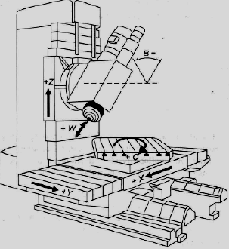
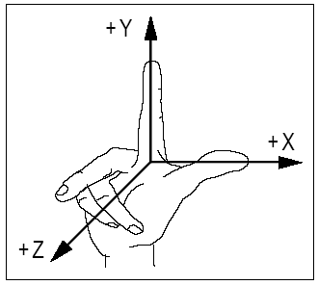
Coordinate systems
The machine tool uses Cartesian coordinate system. First identify the z-axis, x- and y- axes will then follow using the Right hand coordinate system.

Slide 19
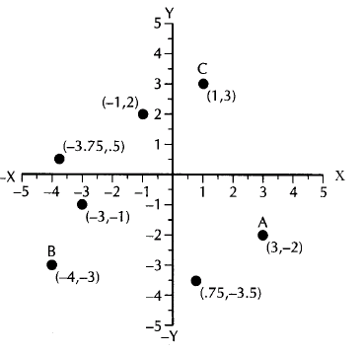
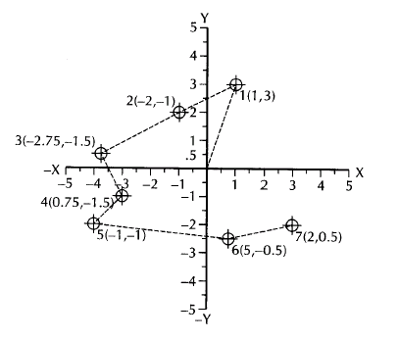
Coordinate systems contd.
Absolute Coordinate System
Incremental Coordinate System

Slide 20
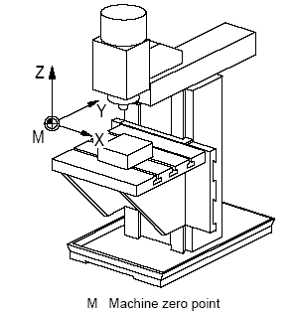
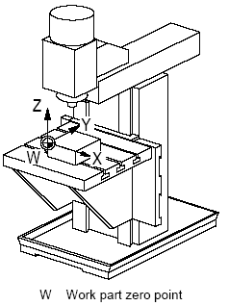
Coordinate systems contd.
Machine coordinate system Work part coordinate system

Slide 21
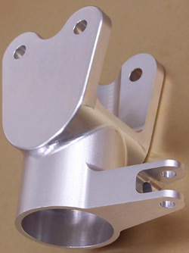
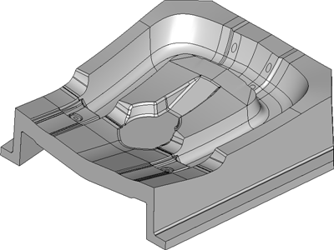
Complex Geometries Machined by CNC

Slide 22
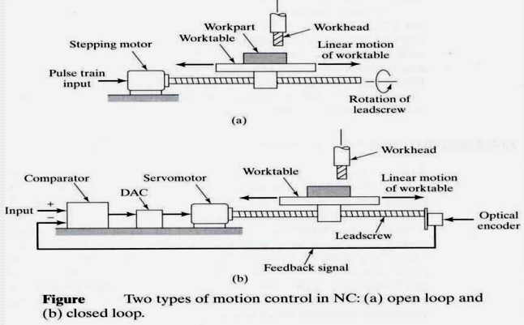
CNC Movement
Each axis consists of a mechanical component, such as a slide that moves, a servo drive motor that powers the mechanical movement, and a ball screw to transfer the power from the servo drive motor to the mechanical component.
These components, along with the computer controls that govern them, are referred to as an axis drive system.

Slide 23
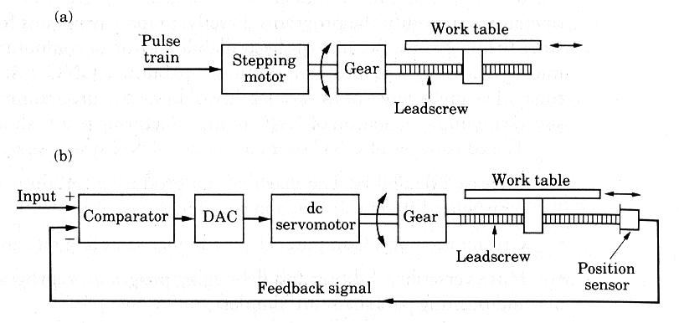

Slide 24
Encoder
Movement is controlled by motors (actuators)
Feedback is provided by sensors (transducers)
An encoder is a device or transducer that converts information from one format or signals to another.
Transducers (such as optical or magnetic encoders) sense position or orientation for use as a reference or active feedback to control position:
A rotary encoder converts rotary position to an analog.
A linear encoder similarly converts linear position to an electronic signal.
Such encoders can be either absolute or incremental.

Slide 25
How CNC Works
Controlled by G and M codes.
These are number values and co-ordinates.
Typed in manually by machine operators or automatically generated by the computer software.
Movement is controlled by a motors (actuators).
Feedback is provided by sensors (transducers)
Tool magazines are used to change tools automatically

Slide 26
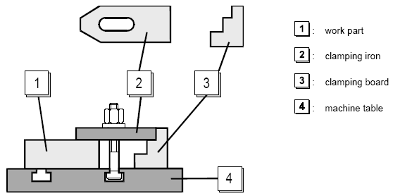
Program Input
Different ways of data input are :
•MDI : Manual Data Input
•PROGRAM PREPARATION WITH CAD/CAM
• PROGRAM DATA TRANSFER FROM PC TO CNC M/C
•PROGRAM DATA TRANSFER FROM PC TO DNC OPERATIONS
Mechanical Clamping Devices

Slide 27
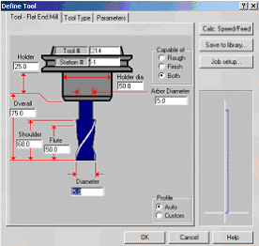
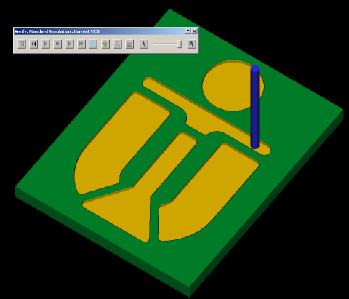
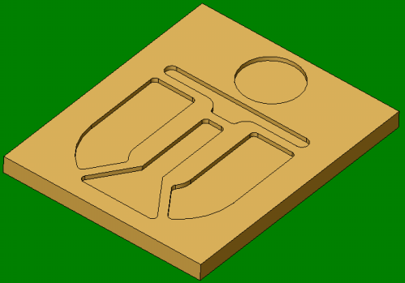
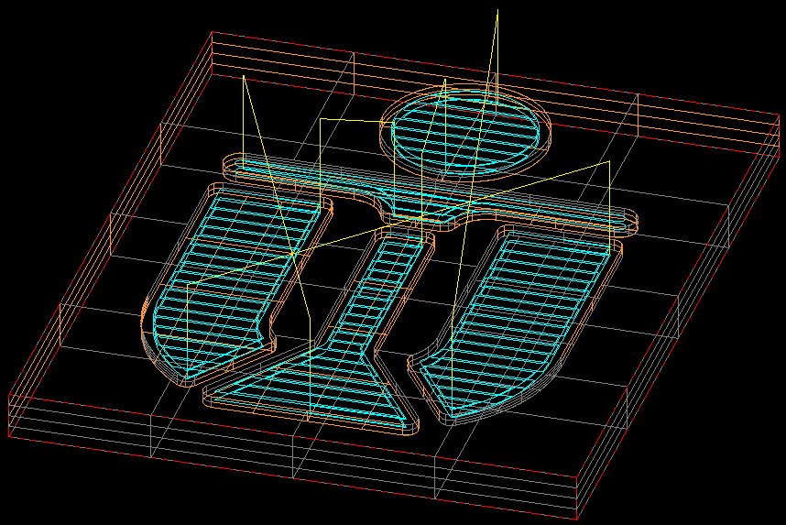
Automatic Part Programming by CAD CAM
Software programs can automatic generate CNC data
Define Tool
CNC data
Make 3D model
Simulate
cutting

Slide 28
CNC programming
Important things to know:
Coordinate System
Units, incremental or absolute positioning
Coordinates: X,Y,Z, RX,RY,RZ
Feed rate and spindle speed
Coolant Control: On/Off, Flood, Mist
Tool Control: Tool and tool parameters
Programming consists of a series of instructions in form of letter codes
Preparatory Codes:
G codes- Initial machining setup and establishing operating conditions
N codes- specify program line number to executed by the MCU
Axis Codes: X,Y,Z - Used to specify motion of the slide along X, Y, Z direction
Feed and Speed Codes: F and S- Specify feed and spindle speed
Tool codes: T – specify tool number
Miscellaneous codes – M codes For coolant control and other activities

Slide 29
Programming Key Letters
O - Program number (Used for program identification)
N - Sequence number (Used for line identification)
G - Preparatory function
X - X axis designation
Y - Y axis designation
Z - Z axis designation
R - Radius designation
F – Feed rate designation
S - Spindle speed designation
H - Tool length offset designation
T - Tool Designation
M - Miscellaneous function

Slide 30
Important G (Preparatory) codes
G00 Rapid Transverse
G01 Linear Interpolation
G02 Circular Interpolation, CW
G03 Circular Interpolation, CCW
G15 Polar Coordinate System off
G16 Polar Coordinate System on
G17 XY Plane,G18 XZ Plane,G19 YZ Plane
G20/G70 Inch units
G21/G71 Metric Units
G28 Return to Reference Point
G40 Cutter compensation cancel
G41 Cutter compensation left
G42 Cutter compensation right
G43 Tool length compensation (plus)
G44 Tool length compensation (minus)
G49 Tool length compensation cancel
G51.1 - X0 X Mirror on
G50.1 - X0 X Mirror off
G00 Rapid move G0 X# Y# Z# up to 6 axis or G0 Z# X# G01 Linear feedrate move G1 X# Y# Z# up to 6 axis or G1 Z# X# G02 Clockwise move G03 Counter clockwise move G04 Dwell time G08 Spline smoothing on, optional L# number of blocks to buffer G09 Exact stop check, spline smoothing Off G10 Linear feedrate move with decelerated stop G11 Controlled Decel stop G17 X Y Plane G18 X Z Plane G19 Y Z Plane G28 move to position relative to machine zero G53 Cancel fixture coordinate offsets G54-G59 fixture coordinate offsets 1 through 6

Slide 31
Important G (Preparatory) codes Contd.
G70 Inch mode G71 Millimeter mode G80 Cancels canned cycles and modal cycles G81 Drill cycle G82 Dwell cycle G83 Peck cycle G84 Tapping cycle G85 Boring cycle 1 bore down, feed out G86 Boring cycle 2 bore down, dwell, feed out G88 Boring cycle 3 bore down, spindle stop, dwell, feed out G89 Boring cycle 4 bore down, spindle stop, dwell, rapid out G90 Absolute mode G91 Incremental mode G92 Home coordinate reset G93 cancel home offsets G98 - G199 User-definable G codes
G51.1 - Y0 Y Mirror on
G50.1 - Y0 Y Mirror off
G53 Work Coordinate System off
G54 …..G59 Work Coordinate System 1…6
G68 Rotation on
G69 Rotation off
G73 Peck Drilling Cycle
G80 Cancel canned cycles
G81 Drilling cycle
G82 Counter boring cycle
G83 Deep hole drilling cycle
G90 Absolute positioning
G91 Incremental positioning
G94 Feed per Minute
G95 Feed per Revolution
G98 Return to Reference point in Drilling Operation
G99 Return to Initial point in Drilling Operation

Slide 32
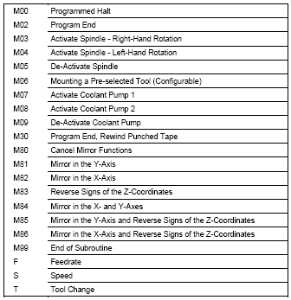
Important M (Functional) codes
M00 Program stop
M01 Optional program stop
M02 Program end
M03 Spindle on clockwise
M04 Spindle on counterclockwise
M05 Spindle stop
M06 Tool change
M08 Coolant on
M09 Coolant off
M10 Clamps on
M11 Clamps off
M13 Spindle CW and Coolant On
M14 Spindle CCW and Coolant On
M30 Program stop, reset to start
M98 Sub-Program Call
M99 Sub-Program Exit

Slide 33
Profile Milling Example
G15 G17 G94 G40 G69 G80
G91 G28 Z0
G28 X0 Y0
M06 T1
M03 S1200
G90 G00 G54 X-30 Y-20
G43 H1 Z10
M08
G01 Z-1 F120
G01 Y20
G02 X-20 Y30 R10
G01 X20
G03 X30 Y20 R10
G01 Y-20
G01 X20 Y-30
G01 X-20
G03 X-30 Y-20 R10
G00 Z5
M09
G91 G28 Z0
G28 X0 Y0
M05
M30

